Slide 1
MINI PROJECT 1 : REGRESSION Business Goal : Model to predict sales of a store
MAITRI NARANG DSFT 8

Slide 2
About Data :
The data contains 14204 records out of which about 40% contained null values in the sales column.
Hence, to tackle this problem we have built a model which will predict those and upcoming sales.
Skewness exists in the dataset, ie. the asymmetry in the data.

Slide 3
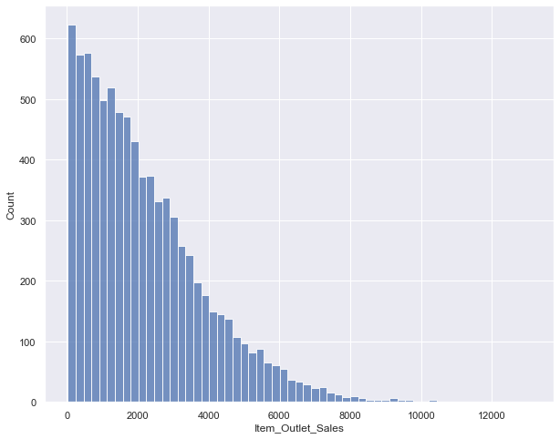
Distribution of total Item Outlet Sales Here, we can observe a declining pattern as the item prices increase.

Slide 4
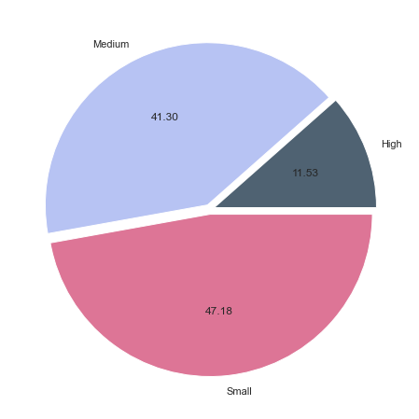
This pie chart tells that the people tend to prefer Low Fat products rather than regular ones.

Slide 5
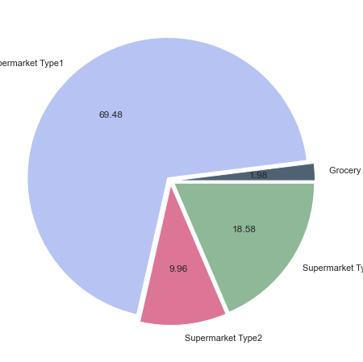
Most of the sales is generated by Super Market Type 1 stores and least sales are generated by the Grocery Stores.

Slide 6
Most sales are generated by Small stores followed by the medium stores.

Slide 7
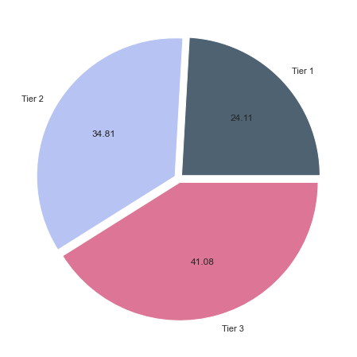
Tier 3 stores have highest sales followed by Tier 2.

Slide 8
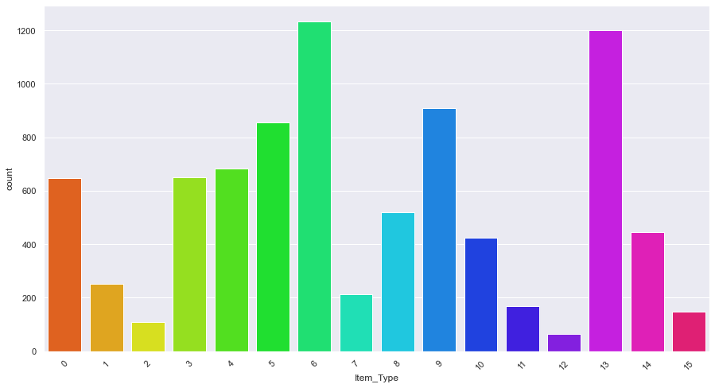
Fruits and Vegetables have highest sales followed by Snack foods. Whereas, Seafood has lowest.¶

Slide 9
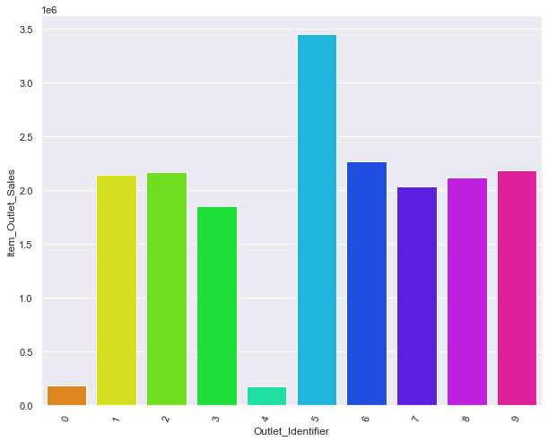
Outlet OUT027 has achieved the highest sales whereas OUT019 and OUT10 have achieved the lowest sales. ¶

Slide 10
CONCLUSIONS:
People tend to prefer Low Fat products rather than regular ones.
Most of the sales is generated by Super Market Type 1 stores.
Most sales is generated by Small stores followed by the medium stores.
Outlet OUT027 has achieved the highest sales.
Some of products which had more visibility are not sold that much when compared with products that did not have any visibility.
Tier 3 stores have highest sales.
Fruits and Vegetables have highest sales.

Slide 11
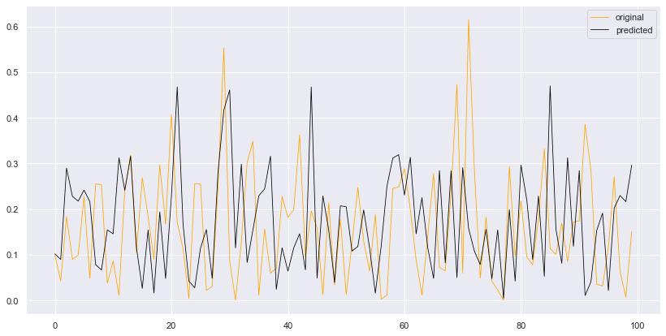
The finalized model to predict the sales shows a performance score of 60% with minimum errors . The plot depicts predictions made over the missing values of sales. We observe a good performance for the predictions. The model I chose here is Random Forest with 60% performance, the performance score is such because of the skewness in the data. The performance can be improved by removing skewness in the data by using various transformation techniques like Sqrt and log transformation.

